Slide 1

Leadership Measurement Instruments
Alisher Siddikov

Slide 2
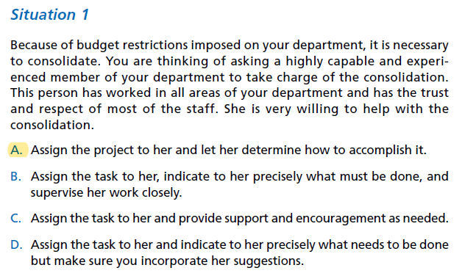

Situational Approach

Slide 3
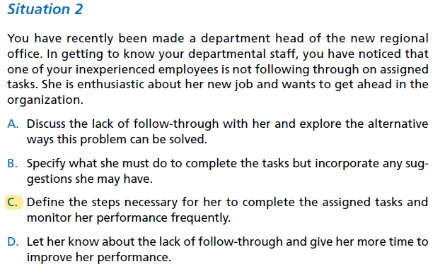
Situational Approach Cont.

Slide 4
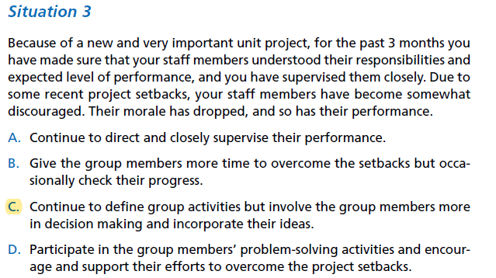
Situational Approach Cont.

Slide 5
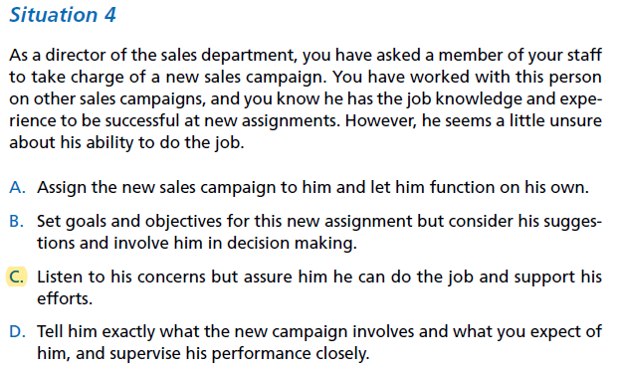
Situational Approach Cont.

Slide 6
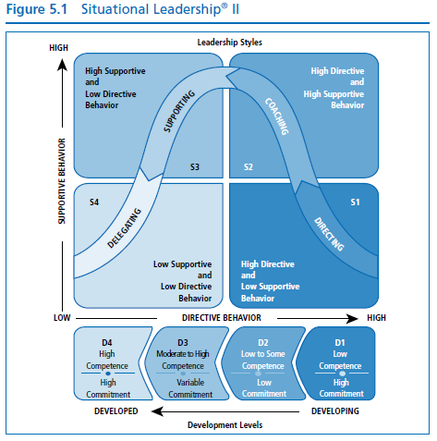
Situational Approach Cont.

Slide 7
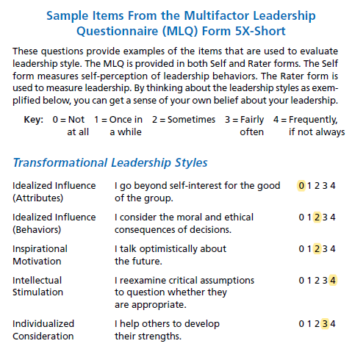
Transformational Leadership

Slide 8
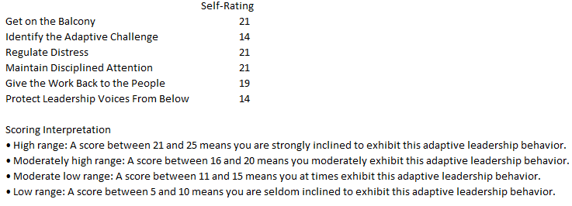
Adaptive Leadership

